Slide 1




Slide 2


Slide 3
Goals for R.I.S.E.
Reading Initiative for Student Excellence
Sharpen the focus and strengthen instruction (based on the science of reading)
Create community collaboration focusing on reading
Build a culture of reading in the state of Arkansas

Slide 4
Purposes of R.I.S.E. Academy
•Discuss current research about how children learn to read
•Narrow the gap between the science of teaching reading and classroom practice
•Strengthen instruction in K-6 literacy
•Question current practices
•Make sure that we are teaching using evidence based practices
•Connect the research to what we do

Slide 5
Science of Reading Legislation
18-19 Districts provide Science of Reading Professional Development Rules and Regulations
K-6 licensed educators demonstrate proficiency in the SoR by 21-22
  Prescribed Pathways
  Two Phases:
    Phase I: Professional Learning
    Phase II: Demonstration
K-12 Special Education educators demonstrate proficiency in the SoR by 21-22.
7-12 licensed educators demonstrate an awareness in the SoR by 21-22
  AETN: Arkansas IDEAS ideas.aetn.org
    18 hours, over next 3 years
LAW Reading Legislation Guidance Document

Slide 6
What Do We Mean By The Science of Reading?
How does the brain learn to read?
How does the brain permanently store words?
What works for prevention of risk in reading?
What works for intervention in reading?
Connecting 40 years of research into classroom practice.

Slide 7
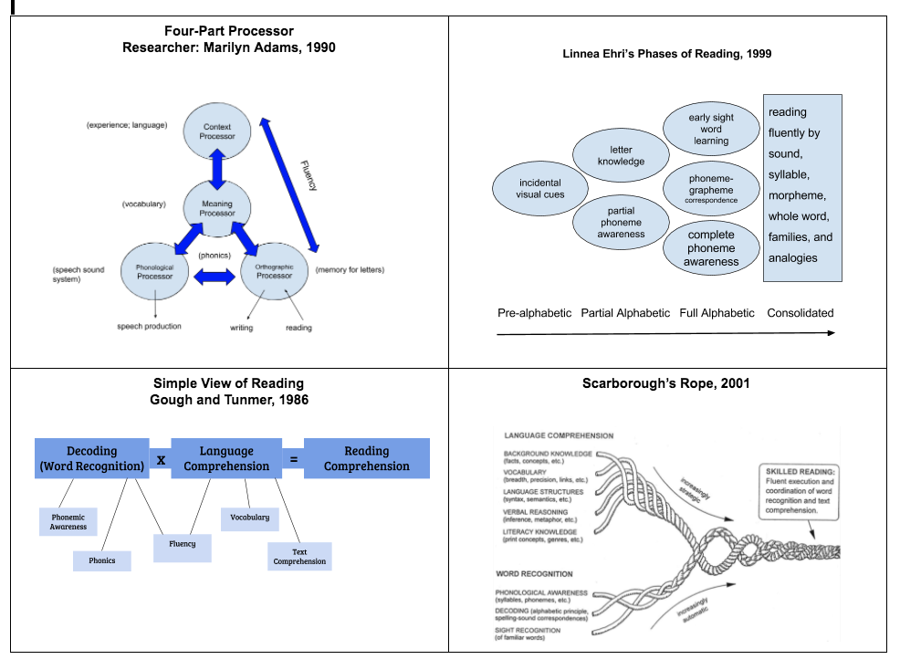
What Do We Mean By The Science of Reading?
4 Theoretical Models

Slide 8
How Many Students Need Intervention?
In a typical class of 25, if only 32% are reading on grade level (NAEP)
8 would be proficient
Out of the 17 that remain,
12 would struggle with decoding and comprehension (70%)
3 would be poor decoders and good comprehenders (20%)
2 would be good decoders and poor comprehenders (10%)
DOES THIS LOOK LIKE YOUR CLASSROOM?
Notes:
If we have 70 percent of our students in tiers 2 and 3 interventions, our tier 1 work needs to be overhauled.

Slide 9
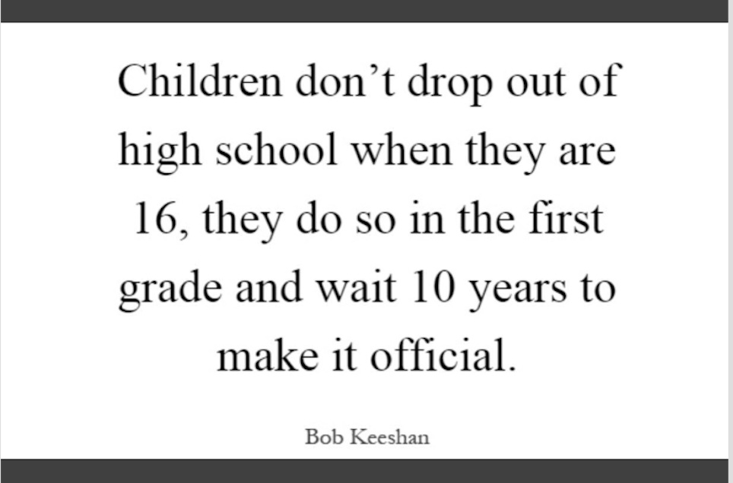

Slide 10


Why Can’t Our Children Read?

Slide 11
Myths of Reading Instruction
That Have Driven Reading Instruction
Myth 1 - Reading is natural.
Myth 2 - Skilled reading involves “guessing” the word based on context.
Myth 3 - Words are stored visually.

Slide 12
Learning to Read is Not Natural
Spoken language is hard-wired inside the human brain. Talking with children guarantees that they will learn to speak (in the absence of pathological interference).
Some children learn to read with minimal instruction, but unlike learning to talk, it is a mistake to assume that they will.

Slide 13
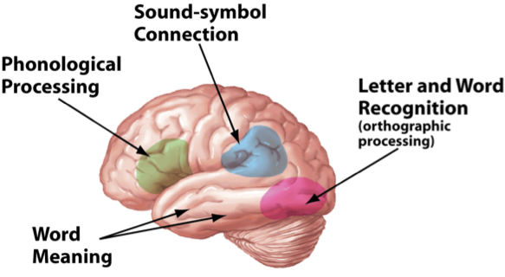

Slide 14
Shift: Reading skills must be taught!
There is no natural connection between the phonological and orthographic processor. We have to create the connection by teaching explicit systematic phonemic awareness and phonics.
Notes:
Just like making a pathway in the woods takes many times up and down a path, creating a circuit between the phonological and orthographic processors takes repeated exposure to phonemic awareness and phonics.

Slide 15
Myths of Reading Instruction
That Have Driven Reading Instruction
Myth 1 - Reading is natural.
Myth 2 - Skilled reading involves “guessing” the word based on context.
Myth 3 - Words are stored visually.

Slide 16
The Problems with the Three Cueing Systems Approach
Skilled word recognition does not require context.
Context is helpful in determining meaning of unknown
words, but is not a primary factor is recognizing unknown
words.
Poor readers, not skilled readers, rely heavily on context.
Weak readers rely heavily on context to guess words due to their limited pool of familiar words as well as their poor phonic decoding skills.
Notes:
The ability to read words in isolation instantly and accurately is the hallmark of being a skilled reader.

Slide 17
The Problems with the Three Cueing Systems Approach
Guessing words from context is not as efficient as phonic decoding.
Even proficient readers are not skilled at correctly guessing
words from context . The accuracy rate is only about 25%.
Contextual guessing does not promote sight-word learning in poor readers.
If weak readers can correctly guess a word from context, they do not have to carefully notice the letter sequence of that word to assist them in making it a familiar sequence for later recognition.

Slide 18
The Problems with the Three Cueing Systems Approach
Semantic errors are not a sign of better reading development than phonetic errors.
Poor readers are more likely to make semantic errors in which they substitute a word that fits the context but is not spelled like the word they are attempting to read. Saying hand for wrist is not superior to saying writ for wrist.
One of the three cues in the three cueing model is not related to word reading.
There is no correlation between syntactical skills and word-level reading. Syntax is essential for comprehension, but not critical for word reading development.
Notes:
Higher quality miscues - not our goal!
Syntax = Structure

Slide 19
The Problems with the Three Cueing Systems Approach
Teaching kids the three cueing system negates the work you are doing in phonics.
Once students think that “reading” is just a matter of looking at the picture, guessing the words, or following a predictable pattern, it is very difficult to get them to actually do the hard work of figuring out the code.
Don’t just ask if we are teaching phonics, but what else do we do?

Slide 20
The Problems with the Three Cueing Systems Approach
The three cueing approach has been the subject of many studies that directly compared it with the phonics approach, also called the code-emphasis approach.
The code-emphasis approach explicitly and systematically teaches students letters and sounds starting in kindergarten.
The code-emphasis approach consistently yields better results in word reading and better reading comprehension than the three cueing systems approach, particularly for weaker readers.
Notes:
No amount of guessing ability will close the gap between poor readers and their typically developing peers. Reading researchers use the 3-cueing system as their control, because everything else works better!

Slide 21
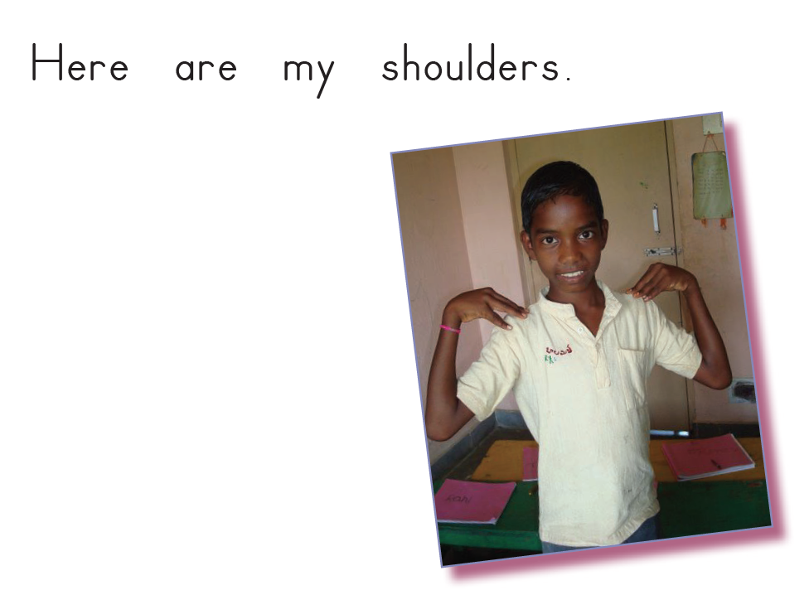
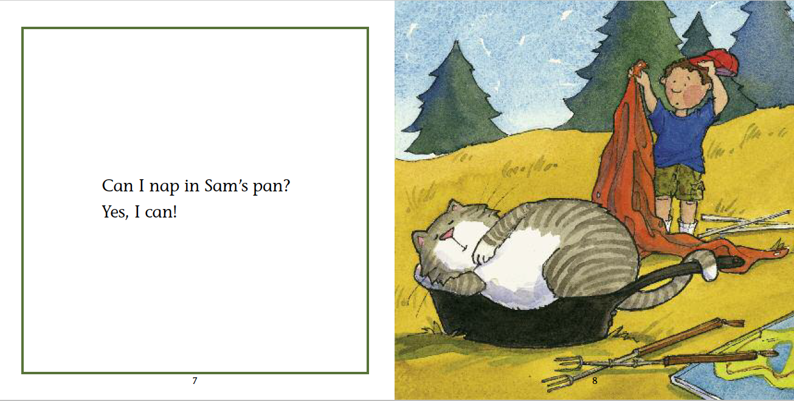
Shift: Skilled readers need to be able to crack the code
Guess the words based on the first letter and the picture.
Decode the words based on letter/sound correspondence.
Notes:
Poor readers need to become proficient in the code of printed English and to build a large sight vocabulary.

Slide 22
Myths of Reading Instruction
That Have Driven Reading Instruction
Myth 1 - Reading is natural.
Myth 2 - Skilled reading involves “guessing” the word based on context.
Myth 3 - Words are stored visually.

Slide 23
Words Are Not Stored Visually
Mixed case experiments
Word recognition is faster than visual recognition
Little or no correlation between visual memory skills and word-level reading
Different regions of the brain are activated when
naming objects than when naming written words
Studies on deaf population
Temporary forgetfulness of names and objects; We
do not forget printed words
Visual memory is not precise enough for efficient word storage
Notes:
Research for why we don’t store words based on their visual look:
Mixed case experiments have demonstrated that we are not retrieving words from a visual memory bank. Otherwise, we would have to memorize every font and type. Instead, we can read a wide variety of fonts, type styles, cursive and manuscript handwriting. (Adams, 1979, 1990; McClelland, 1976). In these studies from the 60’s and 70’s, words were flashed quickly on a screen (1/10 – 1/20 of a second) to college students. Once they got accustomed to seeing words in mixed case, they were able to read any new words printed in mixed case as quickly as they read normally printed words, even though they had not previously seen those test words in mixed case.
Word recognition is faster than visual recognition of objects. You will say “chair” faster when you see the word chair than when you see a picture of a chair. (Cattell, 1886; Simos, Reaie, Fletcher & Papanicolaou, 2013)
Struggling readers and non-disabled students had comparative visual memories. If reading were based on visual memory, students with reading disabilities should have had a lower score on visual memory tests. (Vellutino, 1979)
Phonological awareness correlates quite strongly with word-level reading (Wagner & Torgesen, 1987) which would also be unexpected based on the visual memory hypothesis.
The regions of the brain activated when performing the visual memory task of naming objects (chair, fork, house) differ from the regions activated when naming familiar or unfamiliar written words. (Dehaene & Cohen, 2011)
Most deaf students graduate high school with about a third to fourth grade reading level. If reading was based on visual memory, those who are deaf should not be so impaired in reading. (Hanson, 1991; Lederberg, et al., 2013)
We all temporarily block on the names of people or objects but we do not forget printed words.
Our visual memories are not capable of storing 40,000 to 90,000 words for immediate retrieval.
Kilpatrick’s Essentials of Assessing, Preventing, and Overcoming Reading Difficulties pp. 30-34

Slide 24
How Are Words Stored?
While we input written words visually, we do not store them visually.
Written words are stored on multiple levels simultaneously:
Orthographically (the word’s spelling)
Phonologically (the word’s pronunciation)
Semantically (the word’s meaning)
Notes:
Essentials of Assessing, Preventing, and Overcoming Reading Difficulties – David Kilpatrick, page 34.

Slide 25
How Are Words Stored?
Words are not stored according to their visual properties.
Words are stored based on an alignment between the letter sequence and the phoneme sequence in the word’s pronunciation.
The letter sequences in words are meaningful because the order of the letters is designed to connect the order of the sounds in spoken words.
If a student has phoneme awareness, he can recognize this connection.
Notes:
This is the basic idea behind orthographic mapping.
Automaticity in phonemic awareness to the advanced (manipulation) level is KEY! When orthographic mapping is strong, a student only needs 1-4 exposures to new words to add them to sight vocabulary. If a student struggles with phoneme awareness, he will have trouble remembering words because the letter strings are meaningless. The more connections we have, the better chance we have of retrieving
a word.
Written words are stored on multiple levels simultaneously:
Orthographically (the word’s spelling)
Phonologically (the word’s pronunciation)
Semantically (the word’s meaning).
Kilpatrick – Equipped for Reading Success Pages 31-36
Kilpatrick – Essentials of Assessing, Preventing, and Overcoming Reading
Difficulties pages 96-101

Slide 26
These Common Practices Do Not Match Research
Sight word flashcards
Rainbow spelling
Shape boxes for high frequency words
Memorizing high frequency words
Teaching words as memorized wholes
What theory are these practices based on?
Notes:
What theory are all of these common practices based on? (visual memory)

Slide 27
Shift: Change the way we teach high frequency words.
Start with the sounds heard in the words.
Introduce high frequency words that are regular when you are teaching the syllable type they fall into.
Teach high frequency words that are irregular by focusing on the part that is irregular.
Group irregular words by similar spelling patterns.
Notes:
Teach irregular words the same as regular words – which parts are regular? Focus on the part that is irregular.
Introduce high frequency words that are regular when you are teaching the syllable type they fall into.
Teach irregular words in groups when it makes sense:
(his, is, has, as)
(to, do, into)
(those, these)
(find, kind, mind)
(would, should, could)
(any, many)
(have, give, love)

Slide 28
We Know What Works!
Prevention of risk and successful intervention have three things in common:
Intensive phonemic awareness training, to the advanced level (automatic in phoneme manipulation)
Systematic, explicit instruction in phonics
Substantial opportunity to practice with connected texts

Slide 29
Why RISE?
Narrowing the gap between the Science of Teaching Reading and classroom practice

Slide 30
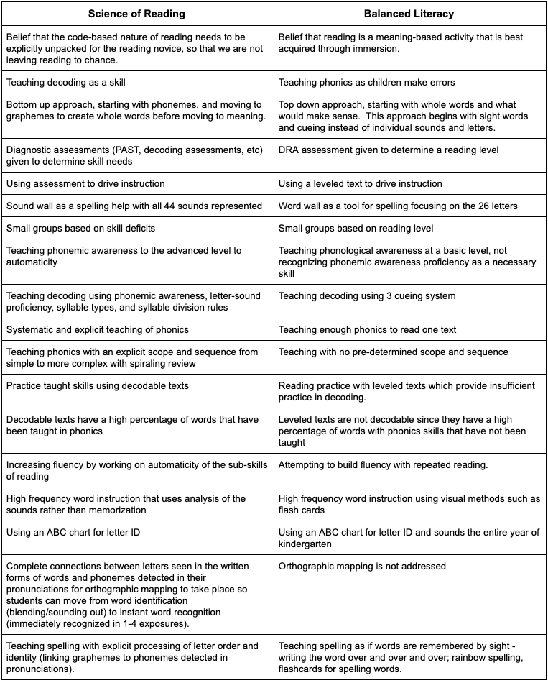
What the research says and evidence proves
How we have been teaching

Slide 31
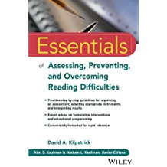
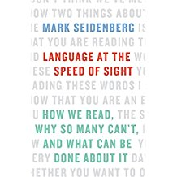
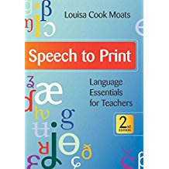

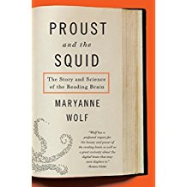
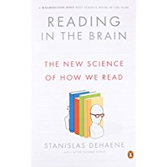
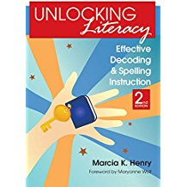
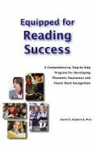
What Research Was Used in Creating RISE Academy?

Slide 32



Continuing Research
At a Loss For Words Podcast
Narrowing the Third Grade Reading Gap

Slide 33
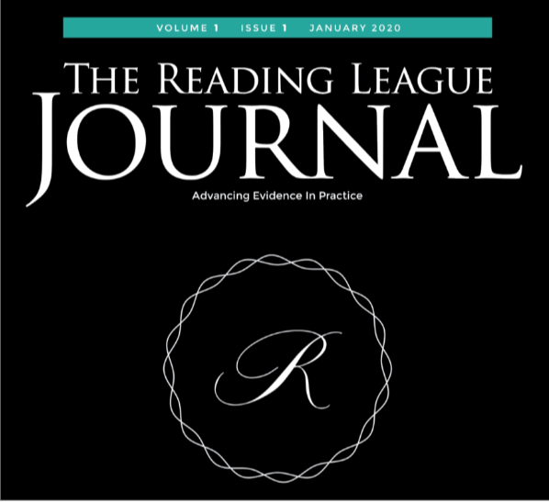

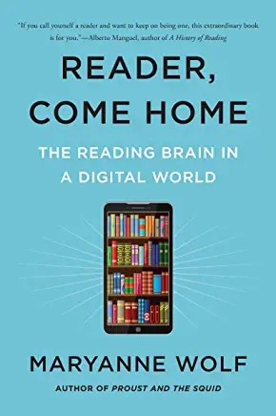
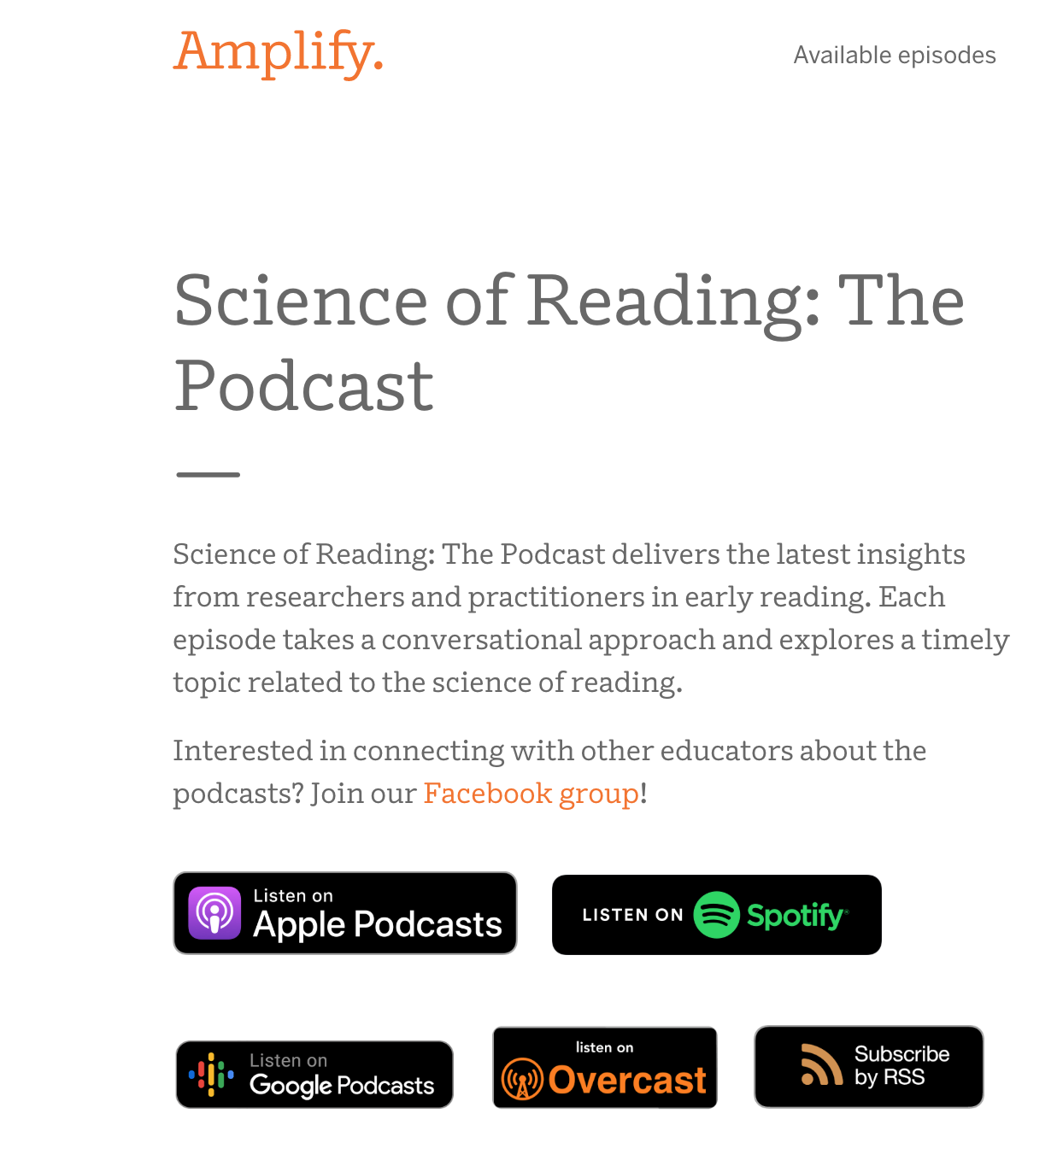
The Reading League
Subscribe to
The Reading League YouTube Channel
Coming January, 2020
Editors: Louisa Moats, David Kilpatrick
New Podcast!

Slide 34
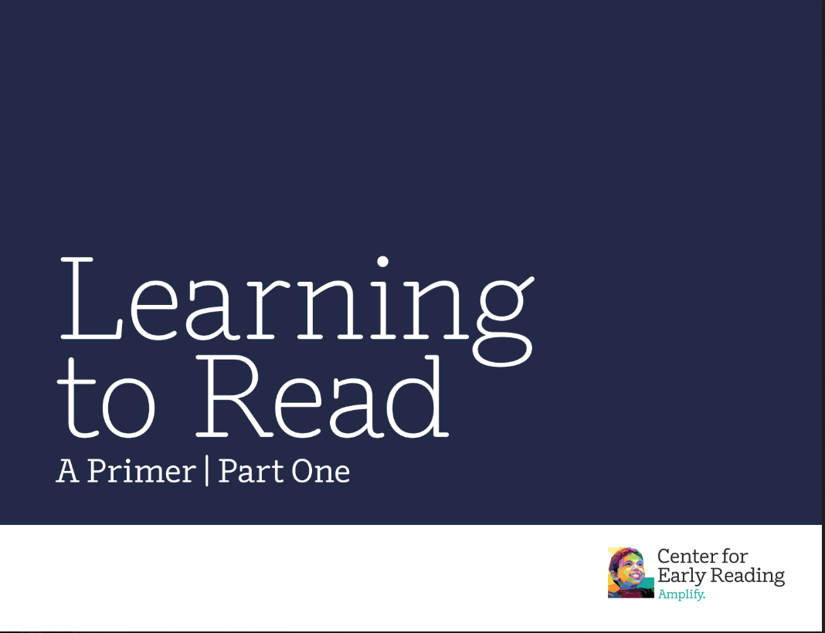
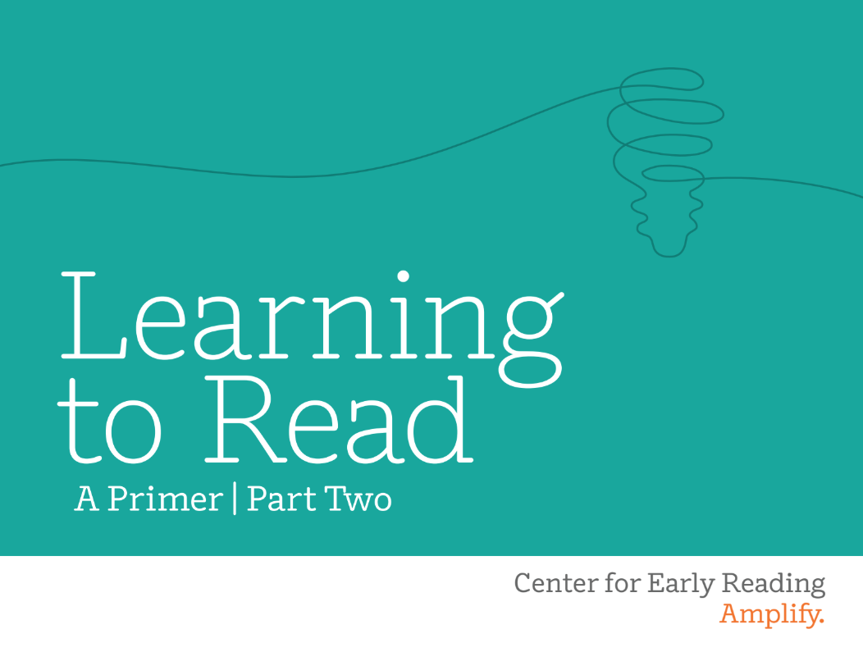
Learning to Read - Part 2
Learning to Read - Part 1

Slide 35
More Research and Resources
Five From Five YouTube Channel
School Psyched Podcast with David Kilpatrick- Assessing and Supporting Reading Difficulties with Dr. Kilpatrick
Dykstra, S. (2013) The Impact of Scientifically-based Reading Instruction on Different Groups and Different Levels of Performance
Castles, A., Rastle, K., & Nation, K. (2018). Ending the reading wars: Reading acquisition from novice to expert. Psychological Science in the Public Interest, 19(1), 5-51.
Read About It: Scientific Evidence for Effective Teaching of Reading (2016)
How Spelling Supports Reading - Moats
The Massive Impact of Literacy on the Brain and its Consequences for Education- Dehaene
Short-changed: Preparation to teach reading in initial teacher education - Buckingham and Meeks
Why Phoneme Proficiency Is Necessary For All Readers- Kilpatrick
Orthographic Mapping Explainer - Lyn Stone

Slide 36
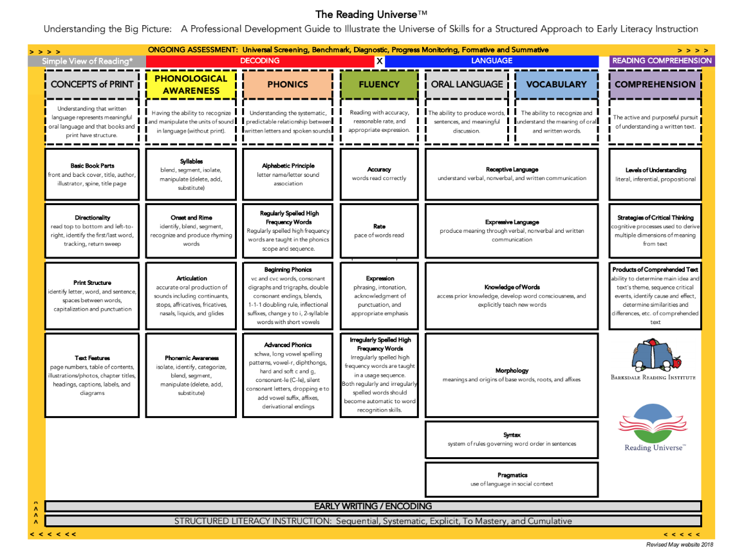
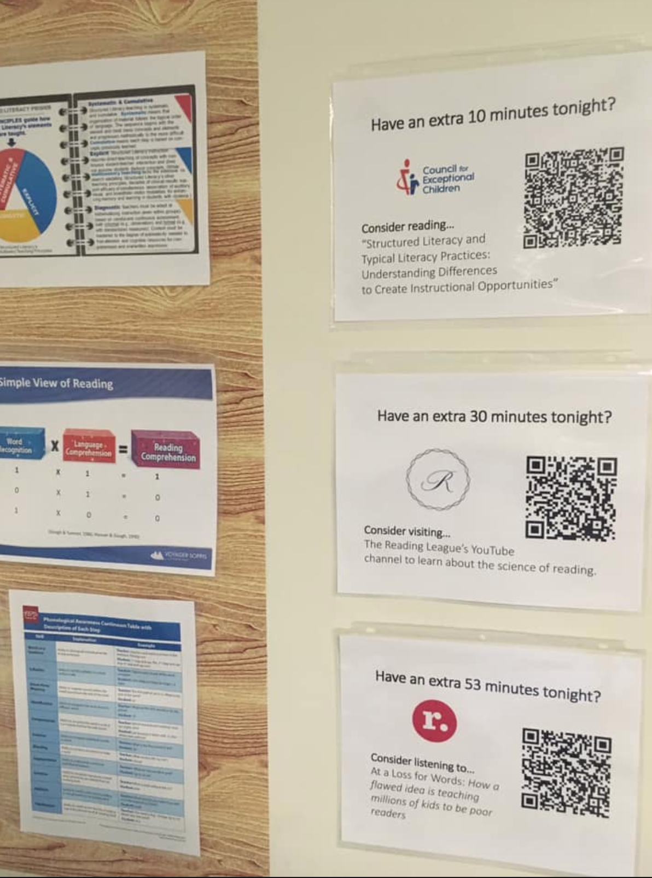
PD on the Go
Notes:
This is a great example of how to plant small pieces of research on your campus for faculty members and students to read.

Slide 37
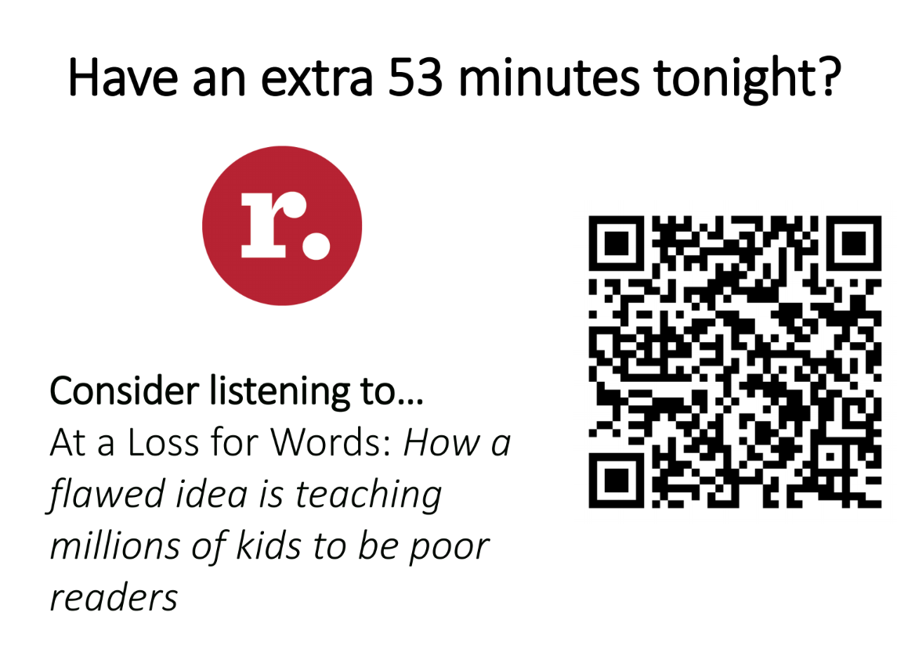

Slide 38
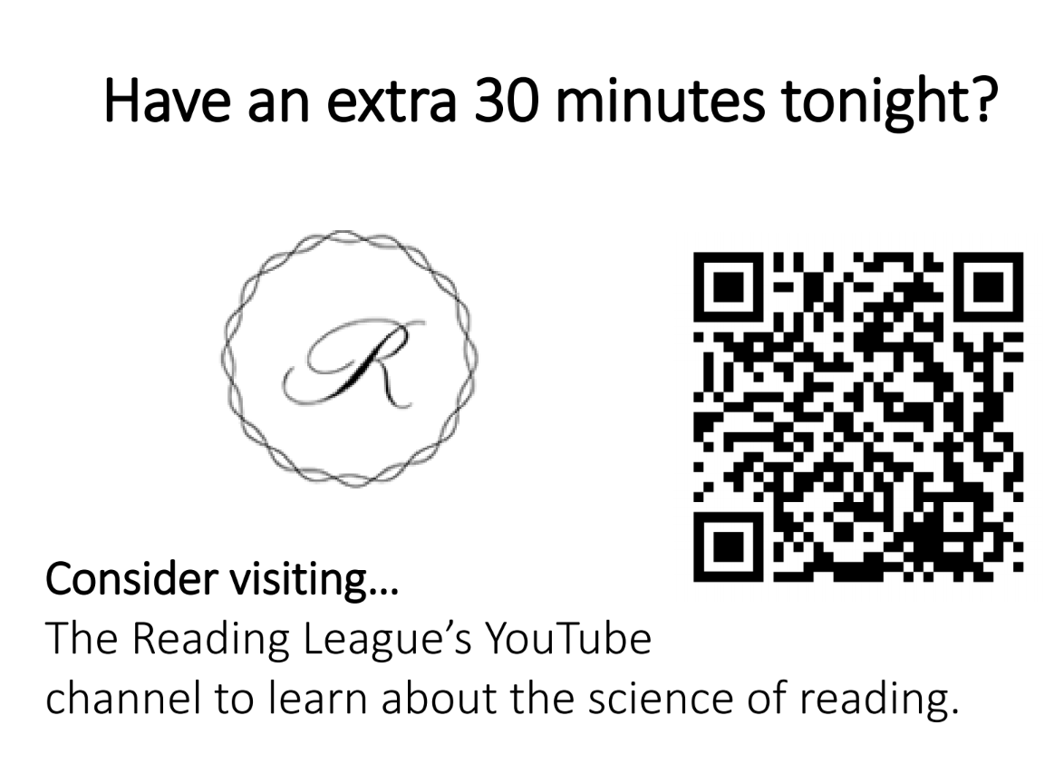

Slide 39
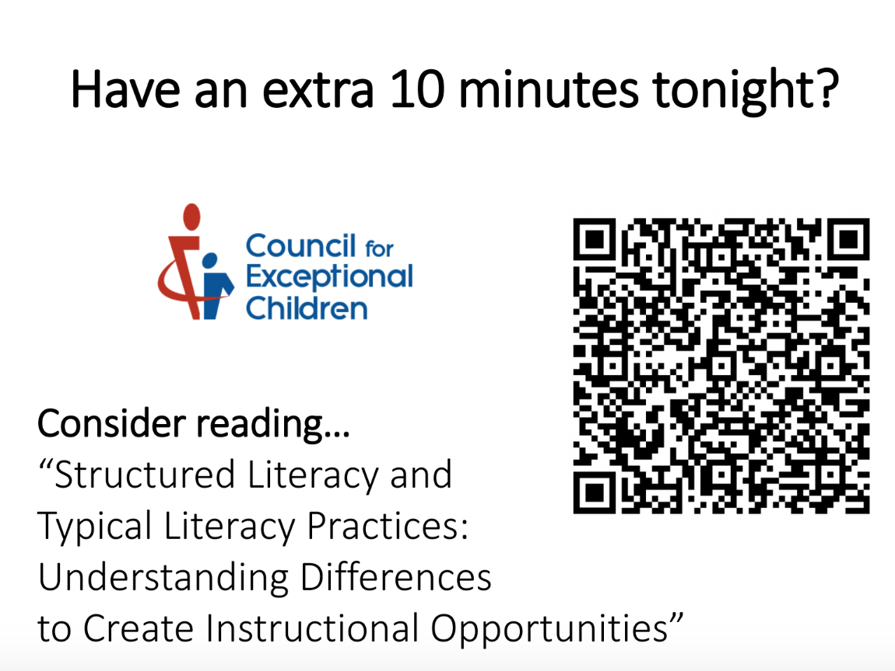

Slide 40
What is Different About a Science of Reading Classroom
Using evidence based methods for teaching reading.
Connecting what neuroscience and linguistics already know about the most efficient ways to teach reading with classroom practice.
Systematic and explicit teaching of phonemic awareness to automaticity at the advanced level.
Systematic and explicit teaching of phonics.

Slide 41
What is Different About a Science of Reading Classroom?
Practice of skills through use of connected text.
Working to automatize the sub-skills when working toward fluency.
Creating a sound wall rather than a word wall.
Teaching high frequency words in a way that matches research.

Slide 42
What is Different About Science of Reading Classroom?
Small group reading based on skills instead of levels.
Focus on diagnostic assessments to determine needs.
Invest in teacher understanding of the science of reading.

Slide 43
The Research is Clear
Only 2-5% of our struggling readers should experience severe reading difficulties.
90-95% of our students can become successful readers!
Implementing the science of how to best teach reading is the path to lead us to this level of success.

Slide 44
RISEArkansas.org

